Slide 1
Model Evaluation and Selection
Lin zhang
Sse, tongji university
Sep. 2016

Slide 2
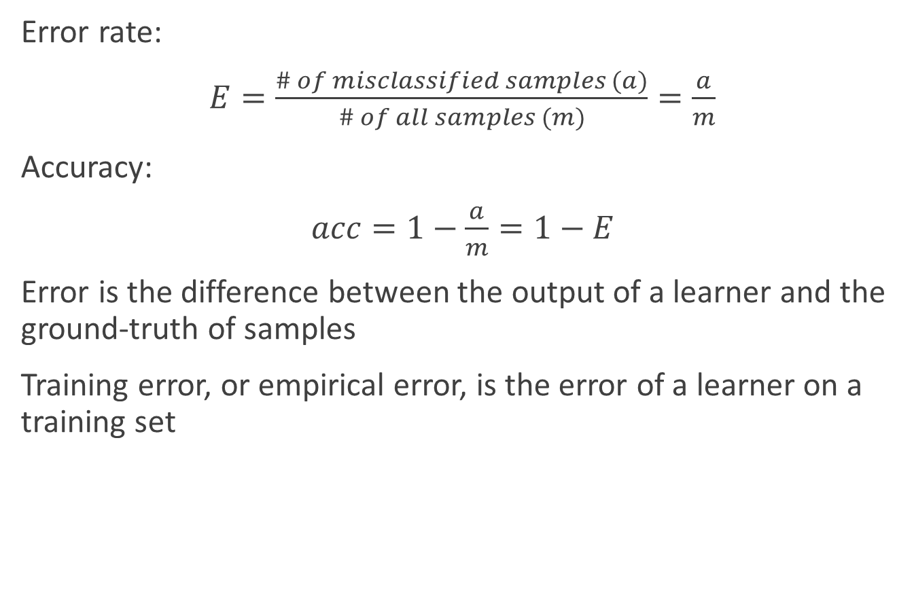
Training error
Error rate:
$E=\frac{\# of misclassified samples (a)}{\# of all samples (m)}=\frac{a}{m}$
Accuracy:
$acc=1−\frac{a}{m}=1−E$
Error is the difference between the output of a learner and the ground-truth of samples
Training error, or empirical error, is the error of a learner on a training set

Slide 3
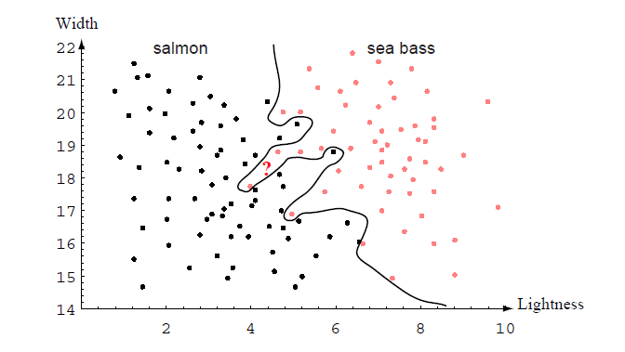
Generalization error
What is a model’s generalization ability?
Generalization error is the error of a learner tested on a new dataset

Slide 4



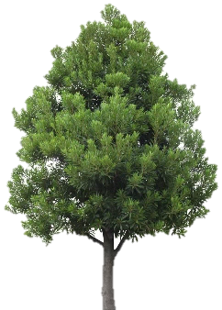
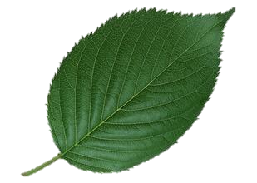
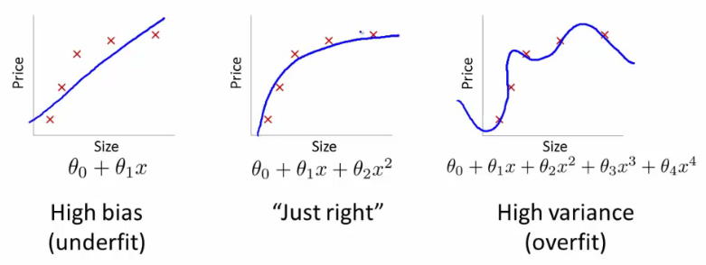
Overfitting
If X
What kind of learners are good?
With small training errors?
With small generalization errors?
Overfitting
Underfitting
overfitting
√
If √
underfitting
Training samples
New samples

Slide 5

Model evaluation methods
Question: Since we hope to choose a model with smallest generalization error, how can we achieve our goal if we only have training samples?
Answer: We can construct a testing set from the given dataset and use the testing error as the approximation of a model’s generalization error.
Training set
…
Original dataset
Testing set
Make sure that samples in the testing set do not appear in the training set!

Slide 6
Model evaluation methods
Methods to construct training set and testing set from the original dataset
Hold-out
Cross-validation
Bootstrapping

Slide 7
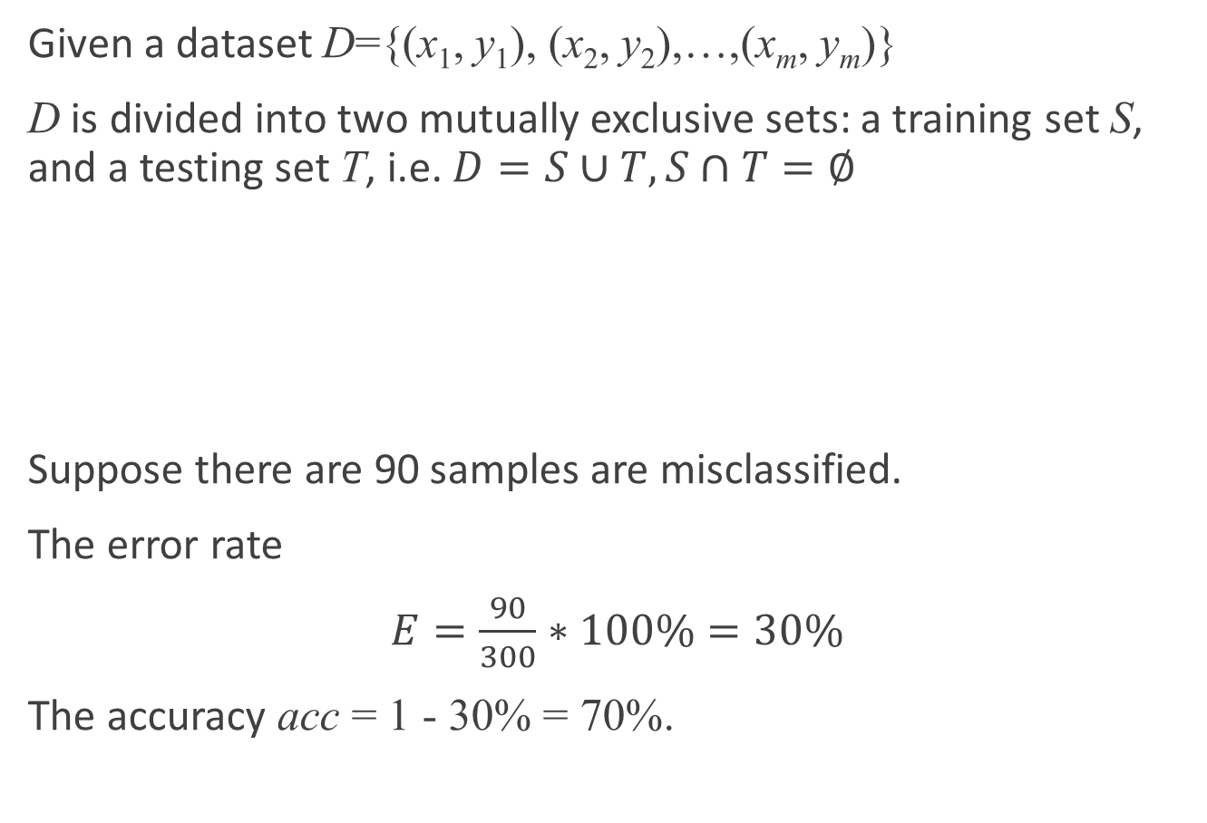
Hold-out
Given a dataset D={(x₁, y₁), (x₂, y₂),…,(x_{m}, y_{m})}
D is divided into two mutually exclusive sets: a training set S, and a testing set T, i.e. $D=S∪T, S∩T=∅$
Suppose there are 90 samples are misclassified.
The error rate
$E=\frac{90}{300}∗100\%=30\%$
The accuracy acc = 1 - 30% = 70%.
D
(1000 samples)
S
(700 samples)
T
(300 samples)

Slide 8
Hold-out
Noted that samples in the training set and testing set should obey the same distribution as samples distributed in the original dataset
When constructing S and T, proportions of samples of difference classes in the training set, testing set, and the original dataset should be the same. (minimum requirement)
Such kind of sampling method called stratified sampling.
For example: If D has 500 positive samples and 500 negative samples, S should contain 350 pos samples and 350 neg samples, and T should contain 150 pos samples and 150 neg samples

Slide 9
Hold-out
It’s far from enough to fix the proportions of different classes in different sets.
Different cut of D produces different training set and testing set.
To evaluate the performance of a learner, we should randomly cut D for example 100 time and test the learner on 100 different testing sets (the size of 100 testing sets should be the same).
The performance of a learner is the average performance on 100 testing set.

Slide 10
Hold-out
Disadvantage
If S is too big, the learned model will be more close to the model trained using D. But because T is too small, the evaluation results may be not so accurate.
If S is small, the learned model may not be fully trained. Then the fidelity of evaluation results will be low.
Usually 2/3~4/5 samples are used in the training process, and the left ones are used to test.

Slide 11

Cross-validation
In cross-validation, D is divided into k mutually exclusive subset, i.e. $D=D_{1}∪D_{2}∪…∪D_{k},D_{i}∩D_{j}=∅ (i≠j)$. D_{i} and D_{j} have the same distribution.
k-fold cross-validation
D
D₁
D₂
D₇
D₈
D₉
D₁₀
D₃
D₄
D₅
D₆
Training set
Test set
D₁
D₂
D₇
D₈
D₉
D₁₀
result 1
D₃
D₄
D₅
D₆
D₁
D₂
D₇
D₈
D₁₀
D₉
result 2
Average performance
D₃
D₄
D₅
D₆
...
D₂
D₃
D₄
D₅
D₆
D₇
D₈
D₉
D₁₀
D₁
result 10

Slide 12
Cross-validation
Many ways to divide D into k subsets.
Randomly divide D into k subsets and repeat the process p time. The final evaluation score is the average score of p times k-fold cross-validation.
Special case of cross-validation: Leave-One-Out (LOO)
Disadvantages

Slide 13
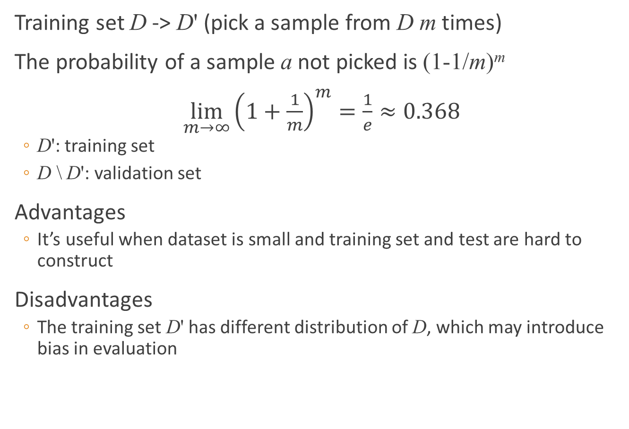
Bootstraping
Training set D -> D' (pick a sample from D m times)
The probability of a sample a not picked is (1-1/m)^{m}
$\lim_{m→∞}{{\left(1+\frac{1}{m}\right)}^{m}}=\frac{1}{e}≈0.368$
D': training set
D \ D': validation set
Advantages
It’s useful when dataset is small and training set and test are hard to construct
Disadvantages
The training set D' has different distribution of D, which may introduce bias in evaluation

Slide 14
Parameter tuning
Different parameters result in different performance of a classifier
In practice, choose a range of variation, e.g. [0, 0.2], and a step size, e.g. 0.05, and determine the value of parameter from (0, 0.05, 0.1, 0.15, 0.2) which corresponds to the best performance
In performance evaluation, we use training set to train the model and use validation set to evaluate it performance
After the model has been learnt and parameters has been fixed, the model should be retrained using the full dataset

Slide 15
Performance measure
Error rate/accuracy
Precision/recall/F1 score
ROC/AUC
Cost-sensitive error rate/cost curve

Slide 16
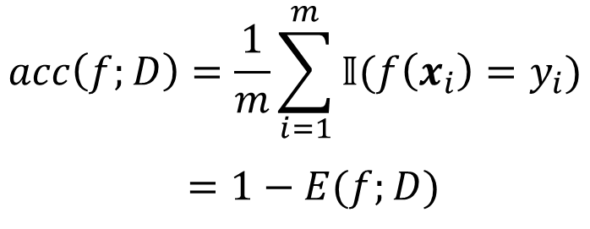
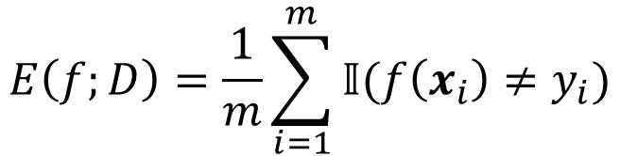
Error rate/accuracy
Given a dataset D, the error rate
Accuracy
$$E\left(f;D\right)=\frac{1}{m}\sum_{i=1}^{m}{\text{𝕀}(f\left(x_{i}\right)≠y_{i})}$$
$$acc\left(f;D\right)=\frac{1}{m}\sum_{i=1}^{m}{\text{𝕀}(f\left(x_{i}\right)=y_{i})}$$
$=1−E(f;D)$

Slide 17
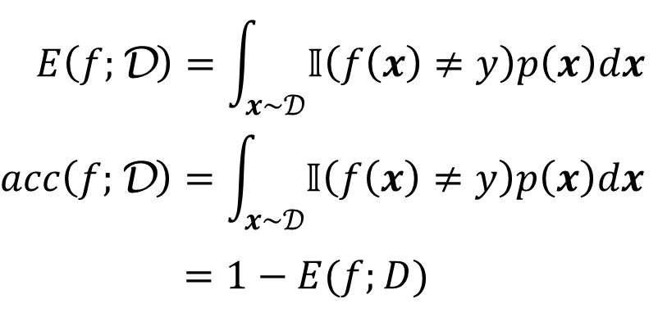
Error rate/accuracy
Given a distribution D and a probability density function p(∙)
$$E\left(f;\text{D}\right)=\int_{x\sim 𝒟}{\text{𝕀}\left(f\left(x\right)≠y\right)p\left(x\right)dx}$$
$$acc\left(f;\text{D}\right)=\int_{x\sim 𝒟}{\text{𝕀}\left(f\left(x\right)≠y\right)p\left(x\right)dx}$$
$=1−E(f;D)$

Slide 18
Confusion matrix
In binary classification problems, samples can be treated as
True positive (TP)
False positive (FP)
True negative (TN)
False negative (FN)
TP+FP+TN+FN = # of all samples
Confusion matrix
 |  | Predicted Class
 |  | Class=1 | Class=0
Actual Class | Class=1 | TP = f₁₁ | FN = f₁₀
 | Class=0 | FP = f₀₁ | TN = f₀₀

Slide 19


Precision and recall
Precision
Recall
P-R curve and Break-Event Point (BEP)
$$P=\frac{TP}{TP+FP}$$
$$R=\frac{TP}{TP+FN}$$
1.0
A
BEP
Precision
0.8
C
0.6
0.4
B
0.2
0
Recall
0.2
0.4
0.6
0.8
1.0

Slide 20
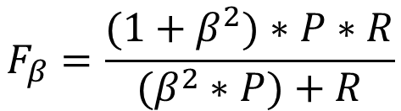
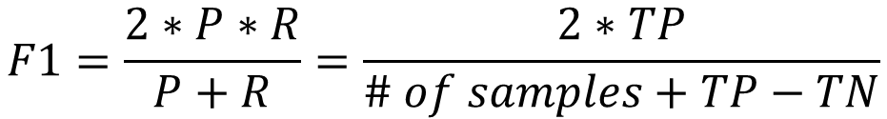
F1-score
F1-score, or F-score:
General form of F-score
β = 1: F1-score
β > 1: Recall is more important
0 < β < 1: Precision is more important
$$F1=\frac{2∗P∗R}{P+R}=\frac{2∗TP}{\# of samples+TP−TN}$$
$$F_{β}=\frac{(1+β^{2})∗P∗R}{(β^{2}∗P)+R}$$

Slide 21
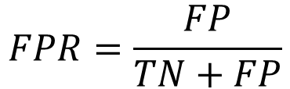
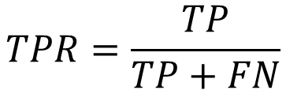
ROC curve
Receiver Operating Characteristic (ROC) curve
True positive rate (TPR)
False positive rate (FPR)
$$TPR=\frac{TP}{TP+FN}$$
$$FPR=\frac{FP}{TN+FP}$$
1.0
ROC curve
TPR
0.8
0.6
0.4
AUC
0.2
0
FPR
0.2
0.4
0.6
0.8
1.0

Slide 22
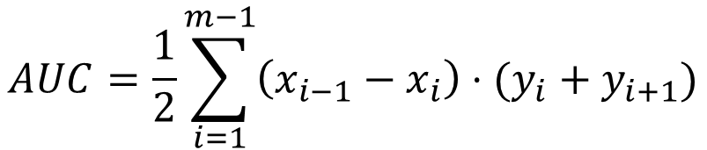
Area Under Curve (AUC)
When two ROC curves intersect, AUC is used to evaluate the performances of two classifiers
$$AUC=\frac{1}{2}\sum_{i=1}^{m−1}{\left(x_{i−1}−x_{i}\right)⋅(y_{i}+y_{i+1})}$$

Slide 23
Cost-sensitive error rate
Different types of errors
Assign different types of errors unequal costs
Cost matrix
Cost-sensitive error rate
 |  | Predicted Class
 |  | Class=0 | Class=1
Actual Class | Class=0 | 0 | cost₀₁
 | Class=1 | cost₁₀ | 0
$$E\left(f;D\right)=\frac{1}{m}\left(\sum_{x_{i}∈D^{+}}{\text{𝕀}\left(f\left(x_{i}\right)≠y_{i}\right)}×cost_{01}+\sum_{x_{i}∈D^{−}}{\text{𝕀}\left(f\left(x_{i}\right)≠y_{i}\right)}×cost_{10}\right)$$

Slide 24
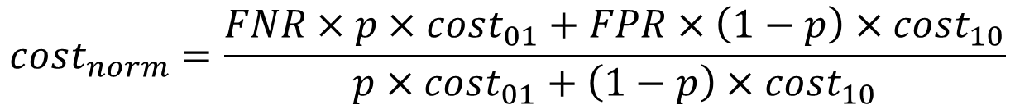
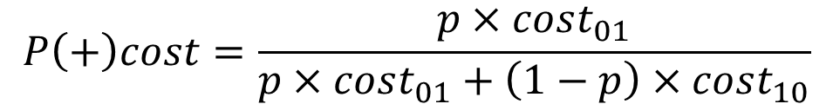
Cost curve
$$P\left(+\right)cost=\frac{p×cost_{01}}{p×cost_{01}+\left(1−p\right)×cost_{10}}$$
$$cost_{norm}=\frac{FNR×p×cost_{01}+FPR×\left(1−p\right)×cost_{10}}{p×cost_{01}+\left(1−p\right)×cost_{10}}$$

